Slide 1



Broadband Strategic Plan Update
Mike Beckstead, SeonAh Kendall, Ginny Sawyer
Notes:
To switch the image, click on the flag pic and delete it. Insert or paste another picture (Please note: too low of resolution and it will not look very good, too much and the file size will get very large) and then send it to back so that it goes behind the header and footer.

Slide 2
Questions and Direction Sought
Is Council in support of the proposed timeline and next steps moving forward?
Is Council supportive of the broadband team’s investigation of the business strategies proposed?
  Models
    Open Access, Retail
  Delivery
    Public/Private Partnership, City only
What additional information does Council need?

Slide 3
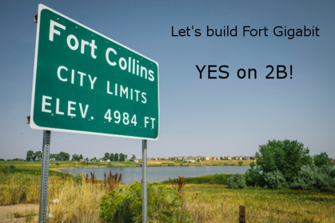
November Election
Passed at 83.2% approval
Forty-seven Colorado communities overturned SB-152 restrictions including Loveland
Private citizen committee advocated for the Fort Collins passage of SB-152 (fortgigabit.com)

Slide 4
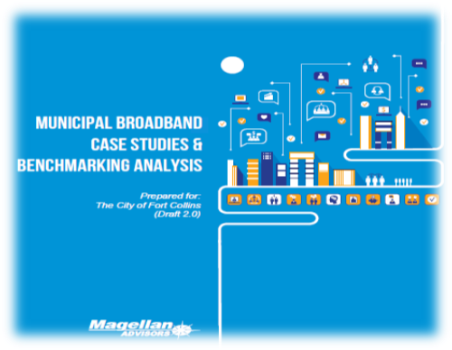
Broadband Case Studies & Benchmarking Analysis
“Moving too quickly can be as risky as moving too slowly”
Notes:
Eighteen communities were evaluated to learn from successes and failures

Slide 5
Broadband Case Studies & Benchmarking Analysis
Evaluation Included
What conditions drove other communities to develop broadband programs?
How do other communities measure broadband success?
How did the benchmark community implement their strategies?
What benefits/challenges were identified?
How did these projects perform financially?
What can Fort Collins learn from these case studies?

Slide 6
Broadband Case Studies & Benchmarking Analysis
What We Learned
  Every community is unique, business models are custom designed to meet local needs
  Financial sustainability is not the only factor in determining success, indirect/soft benefits are important as well
  Financial performance varies widely depending on strategy implemented and can work or fail
  Most communities build their broadband programs over 5-10 years rather than all at once
Notes:
No clear business model wins. All examples of success and failures. Any financial model can work.

Slide 7
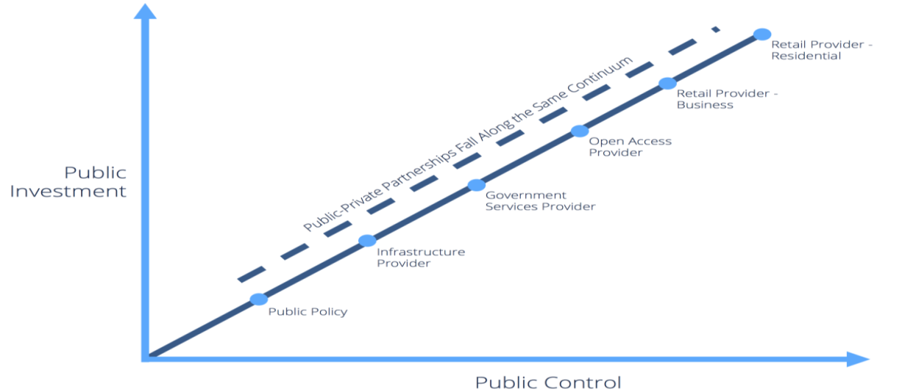
Broadband Case Studies & Benchmarking Analysis
Public Service
Provider

Slide 8
Public Policy Changes
City uses policy tools and standards to streamline construction and reduce the cost of building infrastructure.
Low risk/reward option to support incentives to accelerate broadband investment, but no “quick wins” to improve services
Passive model
Focus includes permitting fee reductions, expedited review and a proposed “dig once” ordinance
Low Med High
Santa Cruz County, CA Knoxville, TN
Notes:
Include graphics
What are the regulatory challenges as we move through the options at the local, state and national level?

Slide 9
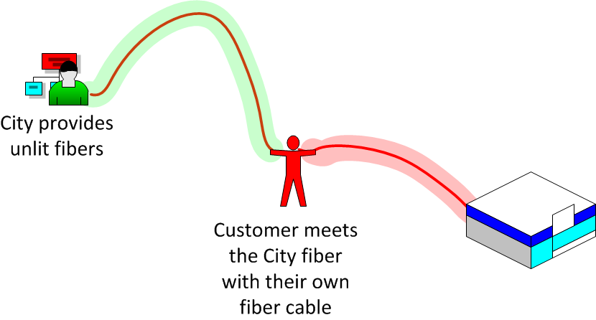
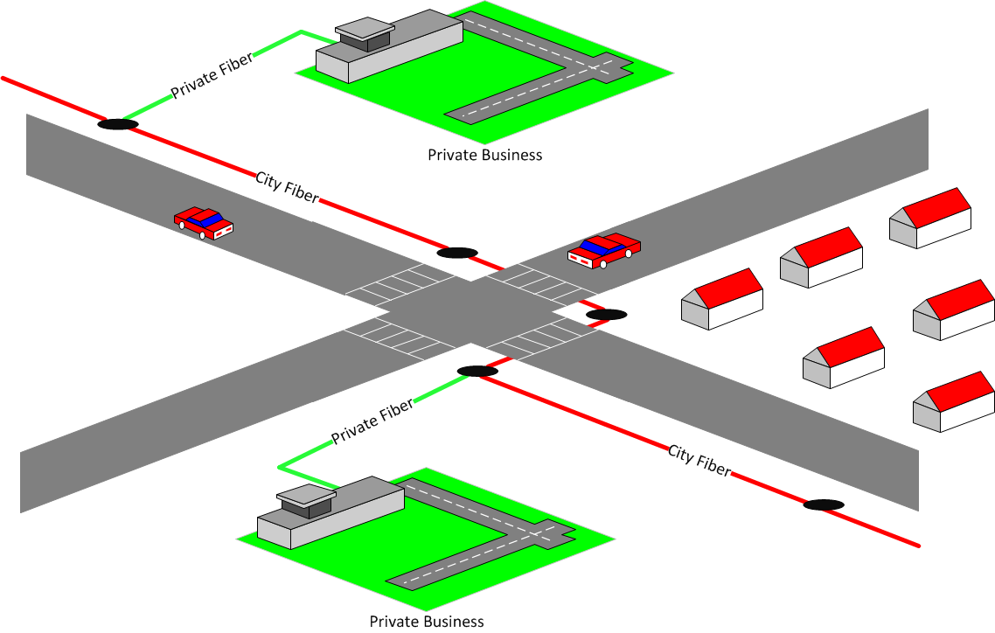
Infrastructure/
Dark Fiber Lease
Dark fiber service only
Improves the cost and availability of fiber infrastructure to businesses, providers and community organizations
Generally not utilized for residential connectivity
Similar to PRPA’s current service
Palo Alto, CA Santa Monica, CA

Slide 10
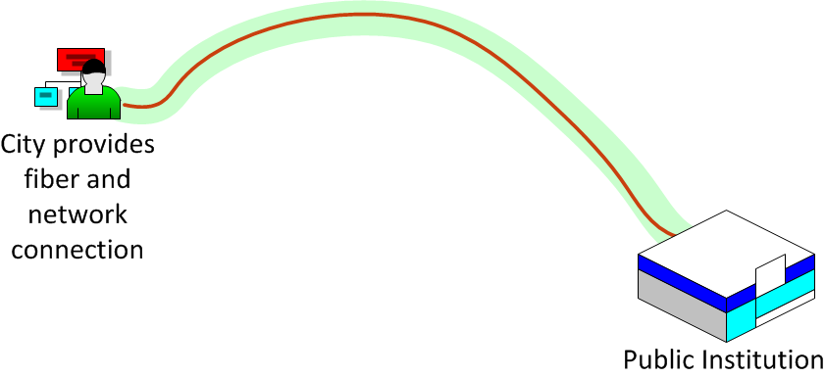

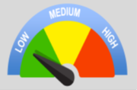
Public Service Provider
City financed and/or shared financing with other public organizations (education, health, etc.)
Provides dark fiber or data services only
Does not engage in retail broadband services
Only connects these organizations to each other
Seminole County, FL Leesburg, FL Columbia County, GA

Slide 11
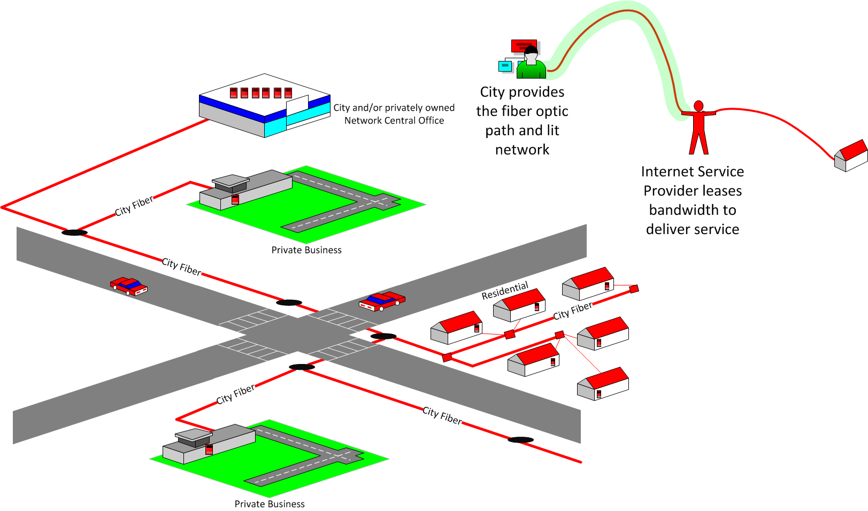
Open Access
City owns and operates the network infrastructure.
Lit bandwidth is provided in an open market to Private Providers to add value.
The City remains neutral and offers transparent pricing to all Private Providers
Danville, VA Palm Coast, FL Provo, UT

Slide 12
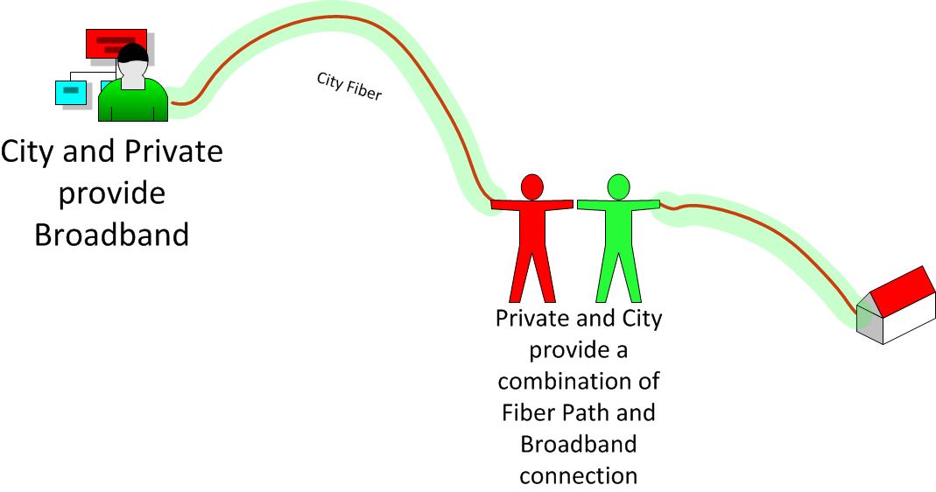
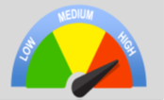
Public Private Partnership (P3)
Newest model – very few cases of networks today permanently using the model. Most are in various stages of negotiation
City assists in building fiber infrastructure with the broadband provider to implement and operate network
Varying degrees of risk and reward (viable partner, financial, regulatory and funding)
Davenport, IA Westminster, MD Missouri

Slide 13
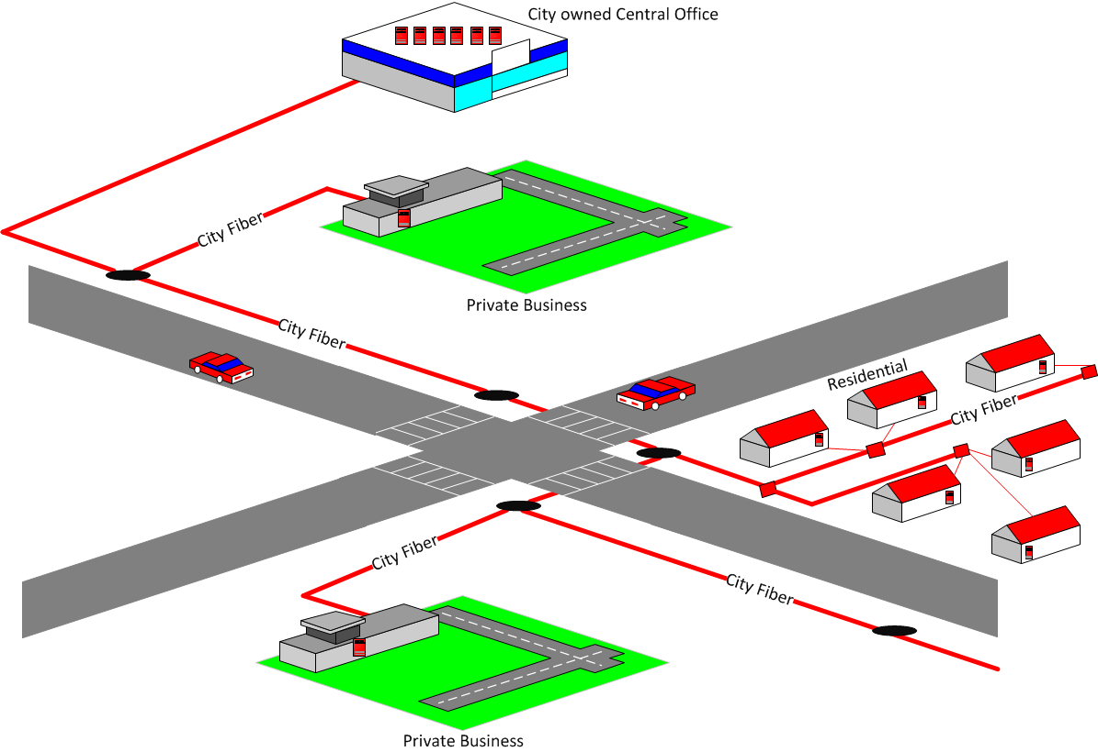
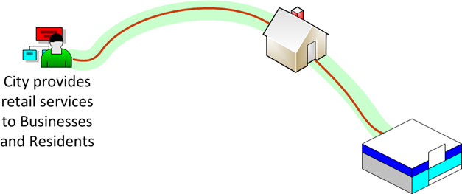
Retail
Enables the City to improve services but requires the City to compete with broadband providers and operate the network
Requires significant investment and operational capabilities
Can include internet, TV, phone and other value-added services
Fort Pierce, FL Hudson, OH Bristol, VA Ashland, OR Morristown, TN

Slide 14
Broadband Case Studies & Benchmarking Analysis
Current City Activity
  The City currently partners with Platte River Power Authority (PRPA) and Colorado State University in dark fiber leasing
  Member of the Fort Collins Community Network (FCCN) a consortium of public-sector partners
  Since 2014, Light and Power Utility has installed standardized communication conduit within electric duct banks
Notes:
Similar to a “dig once” policy but only for L&P but not open for all public/private opportunities

Slide 15
Broadband Case Studies &
Benchmarking Analysis
Public policy should be implemented into any business model moving forward
Universal access has already been identified in the City’s Strategic Plan, so “business only” retail model is not preferred
Broadband expansions are generally phased over 3-5 years
Recommendation for Further Evaluation
Public Private Partnership (P3)
Open Access
Retail (to both residential and business) business models
Notes:
What are we trying to deliver vs how we deliver are two different questions. How do we articulate this???

Slide 16
Market Analysis
Assessment of the current Fort Collins broadband market based on information gained through data collection and research to understand the existing landscape.
Input into business models, financing structures, partnerships, services and participation levels for consideration in developing broadband strategy
Risk reduction

Slide 17
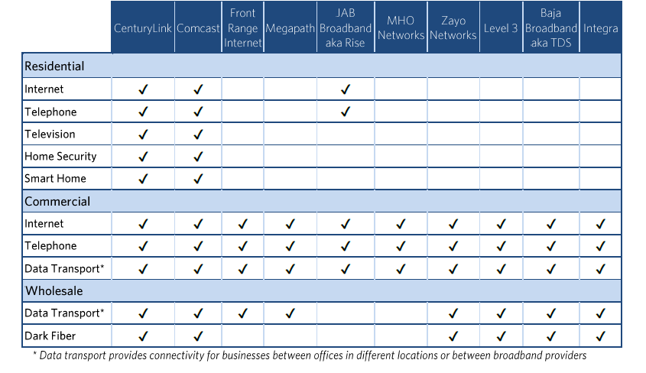
Current Provider & Services in Fort Collins

Slide 18
Market Analysis Findings
Most municipalities that pursue public broadband initiatives have populations of under 100,000
High subscribership can influence the viable options
Lack of affordable fiber products for small/medium businesses creates opportunity
Alignment with City’s capabilities should be evaluated
Multiple providers in the market could facilitate public private partnerships or open-access
Notes:
Largest High-density deployment opportunities
High infrastructure costs should be evaluated (full buildout vs specific areas)

Slide 19
Market Analysis
Fort Collins is #18 in governing.com’s annual list of “America’s Most Connected Cities”
Fort Collins has a 91.4% Internet subscribership rate, indicating that 91.4%
of local households have at least one wired broadband connection
  Issues with speed, reliability and price still exist
http://www.governing.com/topics/transportation-infrastructure/gov-most-connected-cities-2013-internet-adoption-report.html
Notes:
Provide article for Council packet.
Less than 5,000 residential homes without internet connection in FoCO

Slide 20
Moody Report – Key Factors
Municipal broadband faces robust competition from private-sector operators
  Majority of municipalities operate in markets with three or more competitors
Significant ongoing capital investment often results in additional borrowing
  Regular investment for technological upgrades can result in highly leveraged systems
Operating assistance or debt support can strain a local government
Local governments can become unwilling to maintain support
Notes:
In terms of commitment or will to support broadband, could a model similar to KFCG or BOB II funding work vs. debt accumulation?
Operating assistance or debt support can strain a local government seems similar to the bullet about significant ongoing capital investments.

Slide 21
Moody Report –
Characteristics of Strong Enterprise
Debt Structure - Secured by direct General Obligations
Financial Operations - Consistently generates revenue that support debt and operating expenditures.
Political / Community Support - No active organization against muni broadband
Ability of Parent Gov’t to Manage Shortfalls - budgets to support the enterprise
Competition and Offerings - Few competitors, limited array of services
Management Expertise - Presence of on-site management team with industry experience
Notes:
In terms of commitment or will to support broadband, could a model similar to KFCG or BOB II funding work vs. debt accumulation?
Operating assistance or debt support can strain a local government seems similar to the bullet about significant ongoing capital investments.

Slide 22
Next Steps
Ballot Language Set Silent Period
November 3
Election
March 24, 2015 Council Work Session
July 28, 2015 Council
Work Session
Dec. 8, 2015 Council
Work Session
April 26, 2016 Council
Work Session
End of Year 2016 Broadband Strategic Plan & Recommendation Council
Mar Apr May Jun Jul Aug Sept Oct Nov Dec Jan Feb Mar Apr May Jun Jul Aug Sept Nov Dec
Benchmark/
Case Write-ups
SB152
Engagement
Community Engagement
Feasibility Study

Slide 23
Next Steps
  Exploration of Open Access, Public Private Partnership and Retail
  Hired Uptown Services Inc. consulting services
  Update on April 26, 2016 work session
    Ad-Hoc Committee
    Asset Report
    Broadband Service Market Demand Report
      Surveys and engagement
    Target Broadband Standards Report

Slide 24
Next Steps
  Narrowing of Models based on Broadband Service Market Demand Report
  Update on August 23, 2016 work session
    Feasibility Analysis
      More comprehensive analysis by business model
    Strategic, Financial, Operational and Technological Risk and Opportunities Report
  Recommendation to Council - Winter 2016
    Community Report and Feedback
    Broadband Strategic Plan

Slide 25
Community Engagement
  Formation of Citizen Broadband Ad Hoc Committee
  Surveys in the Broadband Service Market Demand Report
  Press Releases (future news articles)
  Website updates (fcgov.com/broadband)
  Social media/online engagement
  Open Houses – Final Feedback
  Possible vote?
Notes:
Work with the community to help determine the best option
DA’s expert review – similar to the audit panel?

Slide 26
Staff Recommendation
Business Model:
 | Open Access | Retail – Residential and Businesses
Service Provided | Transport | Internet & Valued Added Services such as TV and Phone
Customers | Broadband Providers | Residents & Businesses
Funding Required | Moderate | High
Operational Requirements/Costs | Moderate | Very High
Revenue Generation | Moderate | High – Very High
Execution Risk | Moderate | Very High
Delivery of Service
Public-Private Partnership
City
Best Practice
Public Policy Changes

Slide 27
Questions and Direction Sought
Is Council in support of the proposed timeline and next steps moving forward?
Is Council supportive of the broadband team’s investigation of the business strategies proposed?
  Models
    Open Access, Retail
  Delivery
    Public/Private Partnership, City only
What additional information does Council need?

Slide 28
Comparison of Municipal Broadband Business Strategies
 | Public Policy Only | Infrastructure Only | Public-Private Partnership | Public Services Provider | Open Access Wholesale | Retail Provider Business-Only | Retail Provider Residential & Business
Services Provided | None | Dark Fiber Only | None | Dark Fiber, Transport, Internet, Phone | Transport | Internet & Phone | Internet, TV, Phone & Value-Added Services
Customers | None | Broadband Providers | None | Public Organizations Only | Broadband Providers | Businesses | Businesses & Residents
Funding Required | Low | Moderate | Low to High | Moderate | Moderate | High | High
Operational Requirements/ Costs | Low | Low | Low | Low | Moderate | High | Very High
Regulatory Requirements | Low | Low | Low | Low | Moderate | High | Very High
Revenue Generation | Low | Low | Low to High | Low | Moderate | High | Very High
Financial Risk | Low | Low | Low | Low | Moderate | High | Very High
Execution Risk | Low | Low | Moderate | Low | Moderate | High | Very High

