Slide 1
CITYWORKS
Communication & Public Involvement Office
Amanda King, Annie Bierbower, Amy Resseguie and Carson Hamlin
Notes:
To switch the image, click on the flag pic and delete it, as well as the text box with directions. Insert or paste another picture (Please note: too low of resolution and it will not look very good, too much and the file size will get very large) and then send it to back so that it goes behind the header and footer.
To find imagery, see slide 13 to learn about our Flickr site.

Slide 2
What We Do
We serve as a catalyst for world-class municipal service by providing tools, techniques and products that inform, involve and inspire.

Slide 3
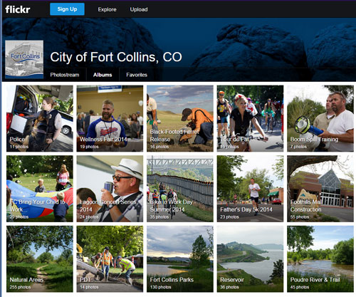
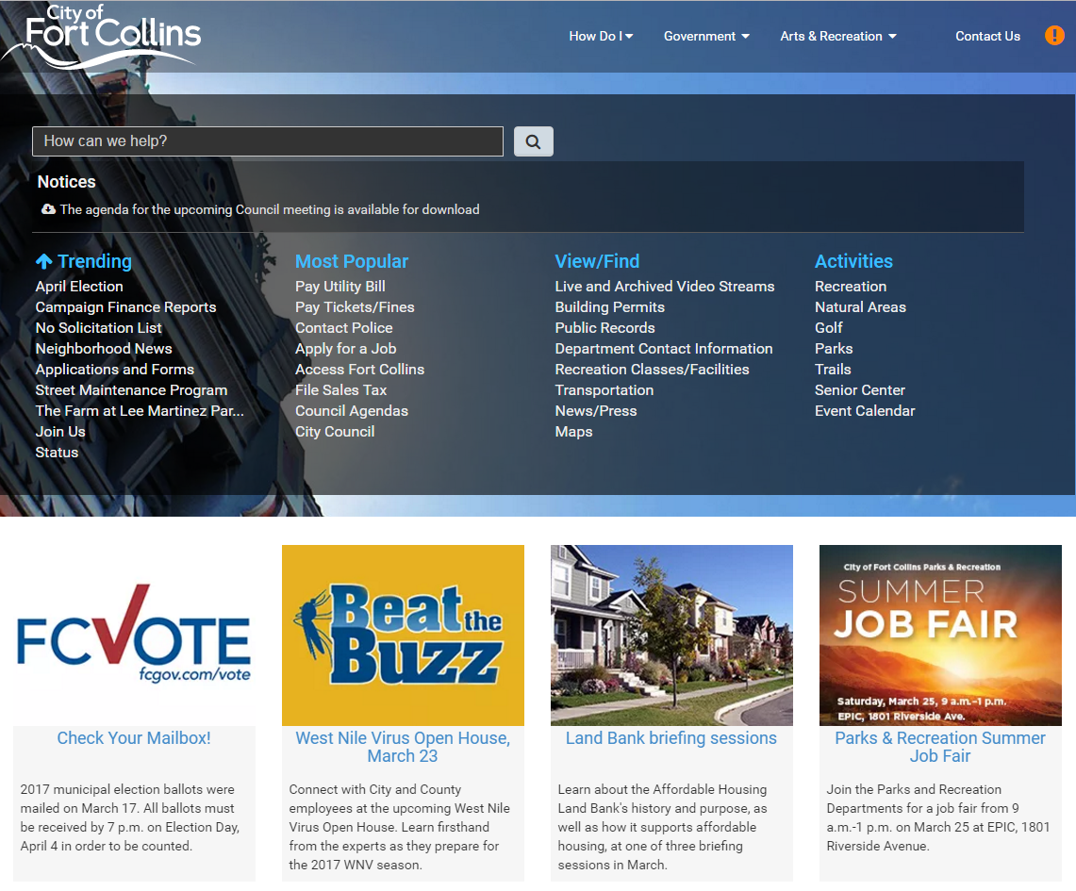
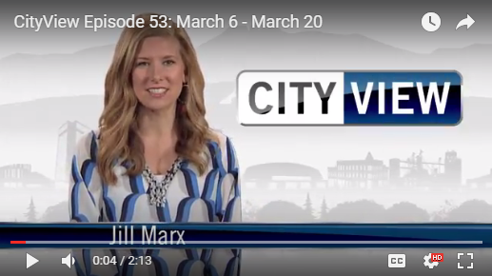
Communications Today

Slide 4
Print

Slide 5
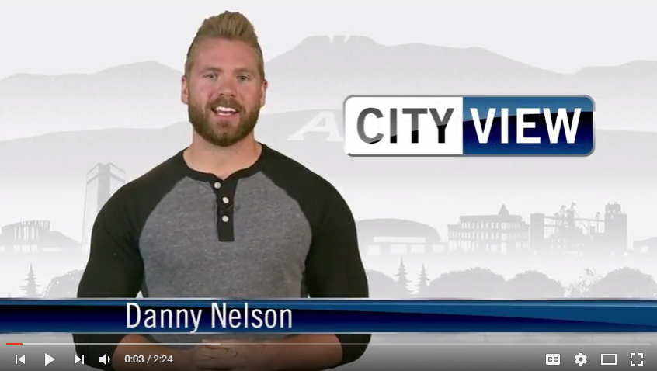
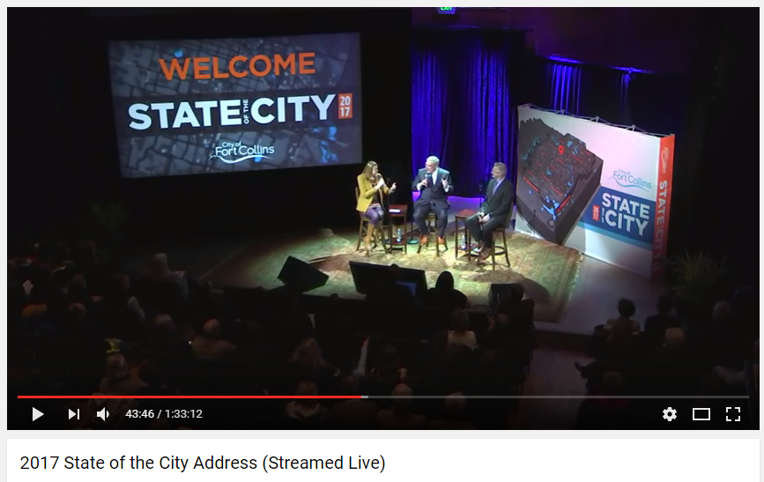
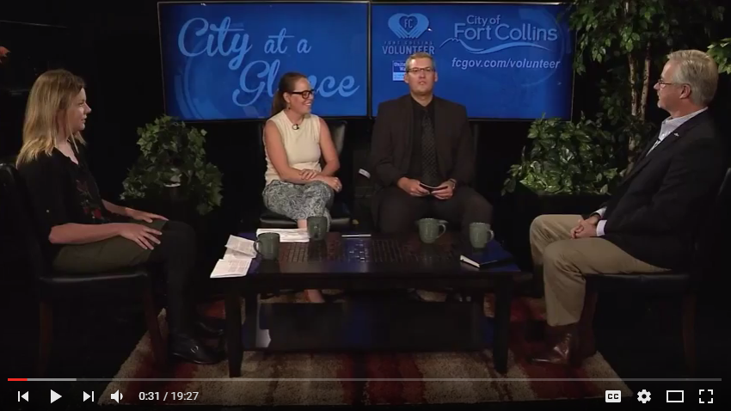
Broadcast/Video

Slide 6
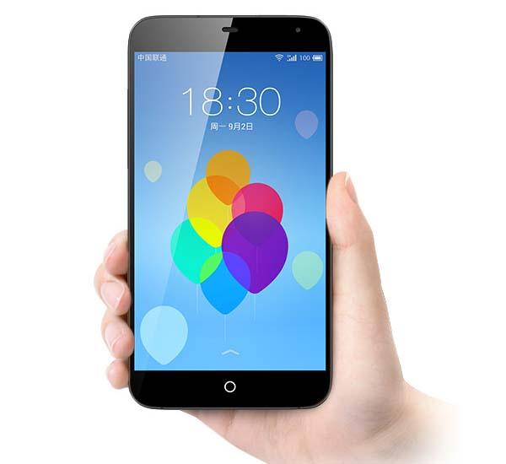
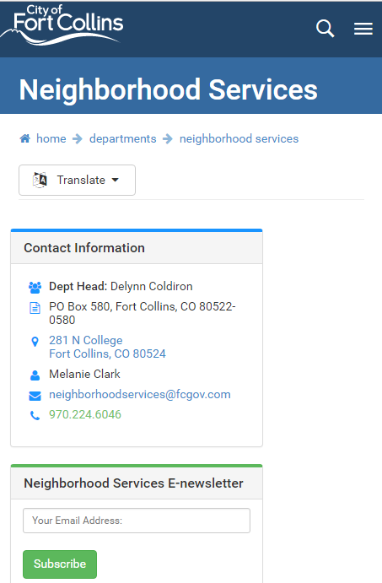
Online – Fcgov.com

Slide 7
Social Media
33
Accredited
Accounts
108K
followers
282K
2016 Avg. Qtrly Engagement
Notes:
Purpose: Accomplish goals outlined by the City of Fort Collins Vision, Mission and Values through effective social media communication.
Platforms: Facebook, Instagram, Twitter, Pinterest, LinkedIn, YouTube and Snapchat

Slide 8
Public Engagement

Slide 9
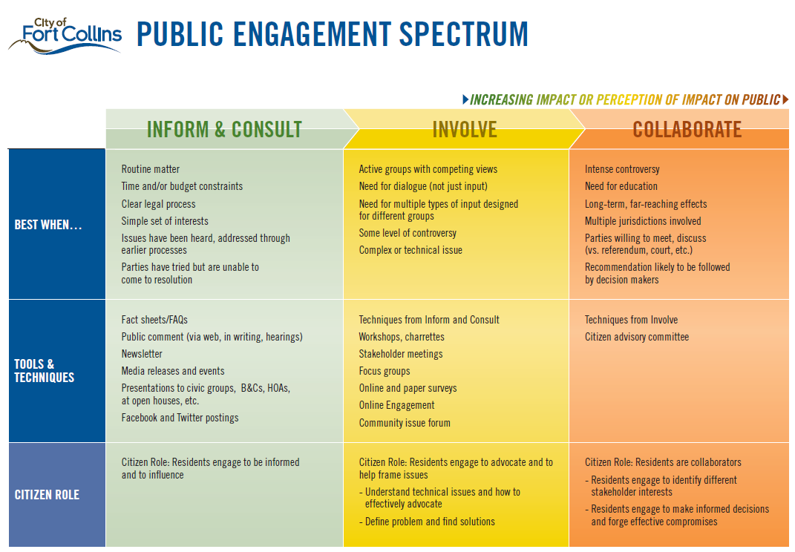
Public Engagement Spectrum

Slide 10
How To Get Engaged
CityWorks 101
Boards & Commissions
Social Media
Council Meetings
Neighborhood Efforts
Public Forums
Technical or advisory groups
Equity committees
Volunteer
Project input (Online polls, etc.)
Online platform (coming soon!)

Slide 11
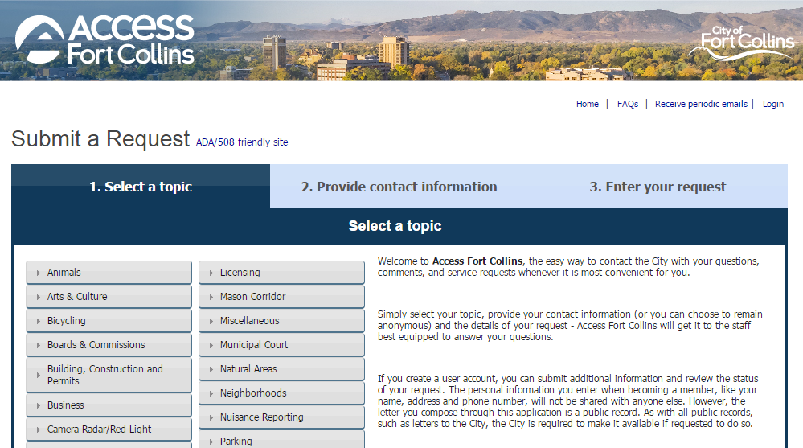
Access Fort Collins
A single, simple point of contact for all City-related requests
24/7 access to the City
Easy to use – you don’t need to know who to talk to
Mobile app is even easier – take a photo, send a request anywhere/everywhere
Not only sends a request; you also get a response

Slide 12
Access Fort Collins

Slide 13
CITYWORKS
Thank you!
Notes:
To switch the image, click on the flag pic and delete it, as well as the text box with directions. Insert or paste another picture (Please note: too low of resolution and it will not look very good, too much and the file size will get very large) and then send it to back so that it goes behind the header and footer.
To find imagery, see slide 13 to learn about our Flickr site.

