Slide 1
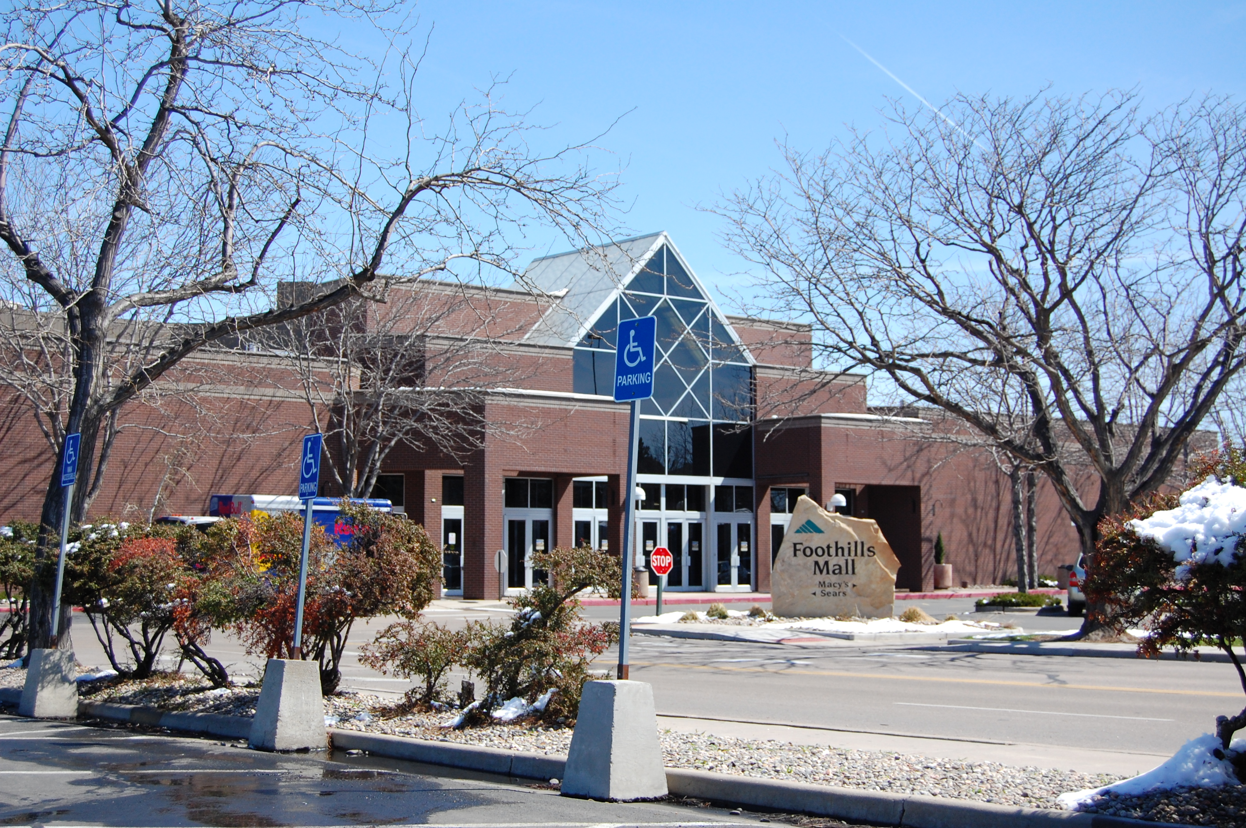
Foothills Mall Redevelopment:
TIF Case Study
4.29.15

Slide 2
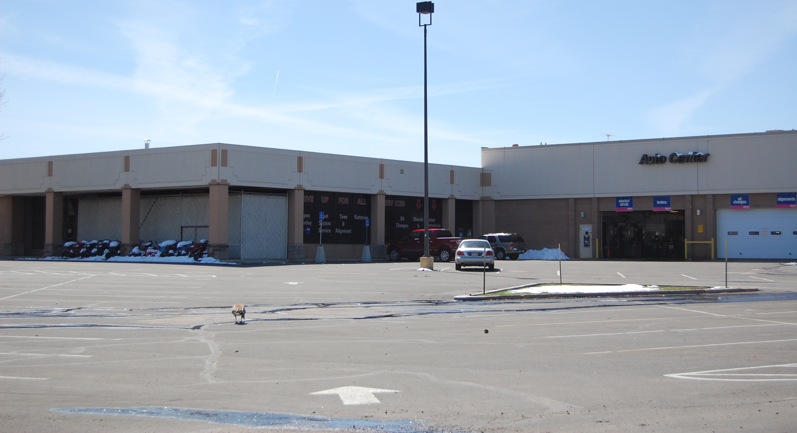
History
1973 – Original Mall Opens
1988 – Mall renovated to add JCPenney & Mervyns
2001 – Mall reaches retail sales high point
2004 – GGP Purchases mall
2010 – Midtown Redevelopment Study
2011 – Midtown Urban Renewal Plan Area Created
2012 – Alberta Purchases Mall
2014 – Redevelopment & Reimbursement Agreement
2015 – Grand Opening of Redeveloped Mall

Slide 3
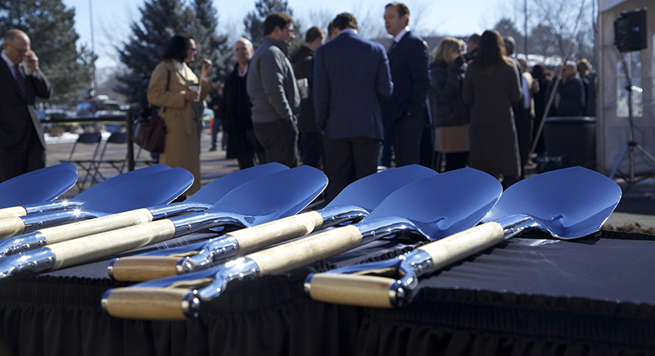
City’s Perspective
Objectives:
Realize Community Vision & Expectations
Launch a Catalytic Opportunity in Midtown
Realize a Significant Revenue Opportunity
Minimize Risk to Balance Sheet, Credit Rating & Revenue
Challenges
Build a Competitive Design & Create a Sense of Place
Resolve Tenant Issues
Create a Connection with Mason BRT
Replace the Youth Activity Center

Slide 4
Project Description
76.3 acres
660,000 SF Retail
446 Residential Units
Theater
Parking Garage
2 Outdoor Plazas

Slide 5
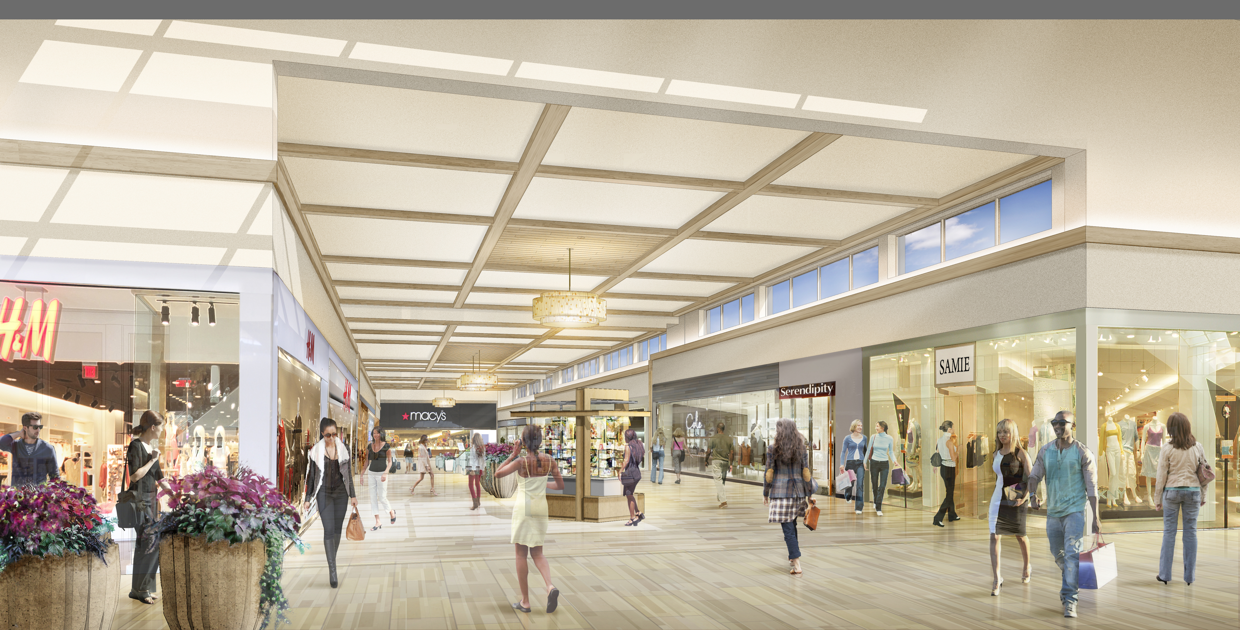
Public Financing
REVENUE SOURCES
Property tax increment.
Excludes District levies and certain school district levies.
Sales tax increment.
City 2.25% rate.
Add-On PIF.
1.00%
District Debt Service Levy.
50 mills
District specific ownership taxes.

Slide 6
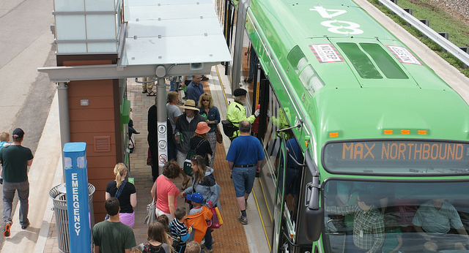
MAX as a Catalyst

Slide 7
Public Amenities

Slide 8
Midtown Possibilities

Slide 9
Major Projects
Redevelopment of the Square
Trade Joes, Sierra Trading Post, Christie Sports
Kings Soopers at the K-Mart Site
Midtown In Motion
Plans to improve vehicle and multi-modal access along the corridor
Foothills Activity Center is OPEN!

Slide 10
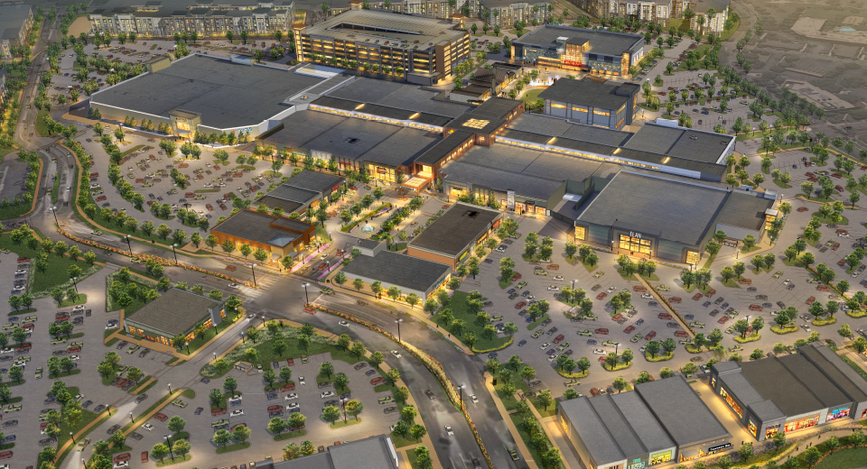
Questions ?

