Slide 1
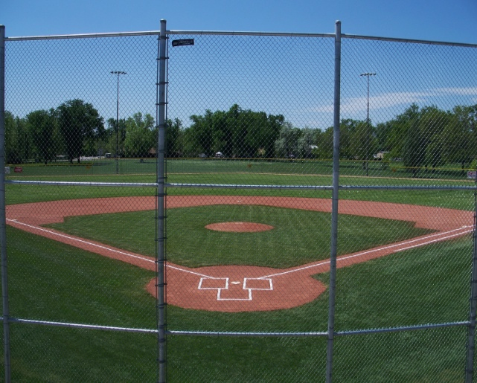
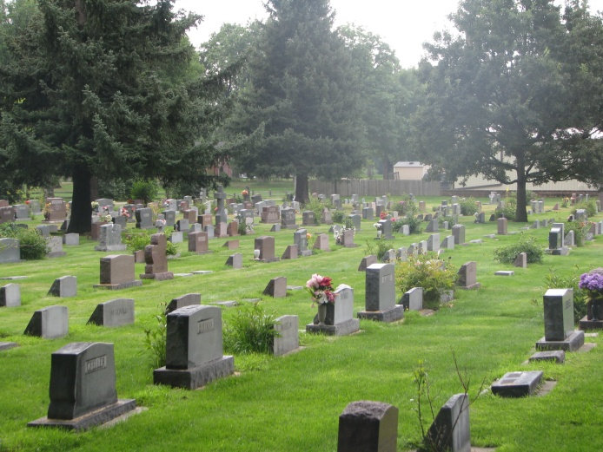
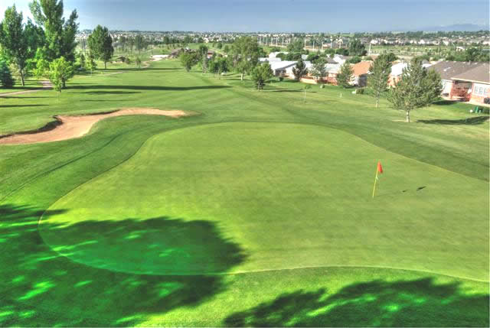
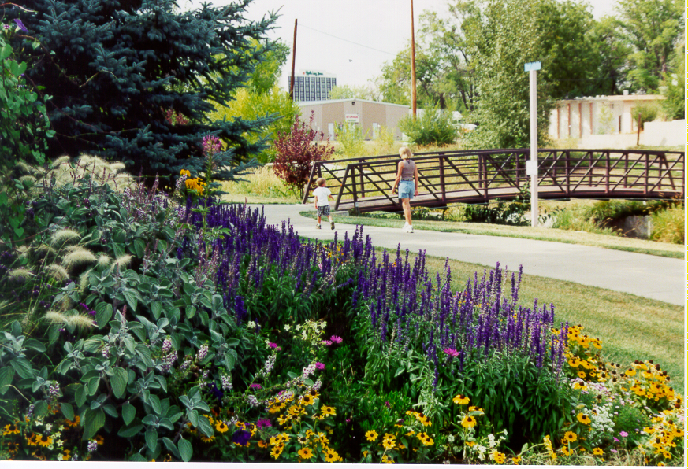
Parks Department
Caring for our public spaces is what we do!

Slide 2
Parks Department Mission
Excellent care of parks & public spaces for the community

Slide 3
Vision
We care just as much about the product we deliver as the people who deliver it. Our goals are to promote professional development, safety and wellness, service to our community and a lasting legacy of stewardship and camaraderie.

Slide 4
Parks Department Structure
There are five divisions in the Parks Department
Parks
Golf
Forestry
Cemetery
Gardens on Spring Creek

Slide 5
Interesting Facts
The annual budget exceeds $13 million
We employ over 200 classified and hourly staff in the summer months
We maintain over 1,000 irrigated acres of parkland,
golf courses, and cemetery grounds
Over 1,600 acre feet of water used for irrigation
80% of water used is raw water
Over 20,000 volunteer hours
93% of the respondents in the 2012 citizen survey rated the quality of Fort Collins Parks as either “high” or “very high”
Visitation exceeds 3.5 million annually

Slide 6
More Interesting Facts
86,000 rounds of golf played
5,868 number of games and practices played
Hosted 496 events throughout the parks
Over 40,000 trees maintained in the urban forest valued at $30 million
Tree removal & pruning generates approximate 4,500 cubic yards of mulch annually
We average 225 interments at the Cemeteries annually
37,000 flowers planted in the downtown core
All 6 community parks, Grandview Cemetery, and all 3 City Golf Courses are certified as Audubon Cooperative Sanctuaries

Slide 7
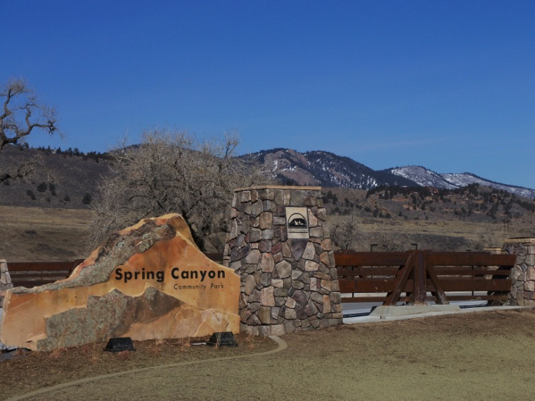
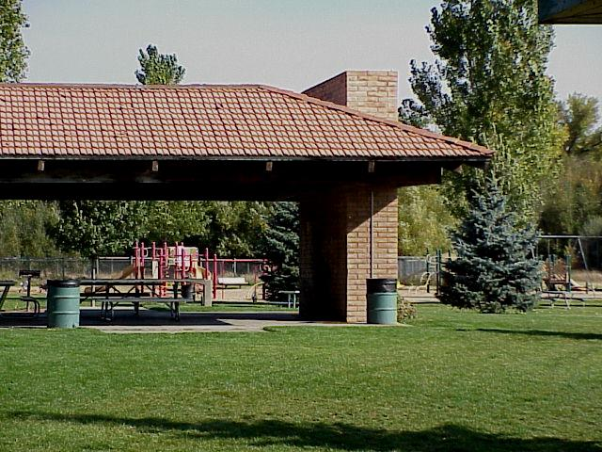
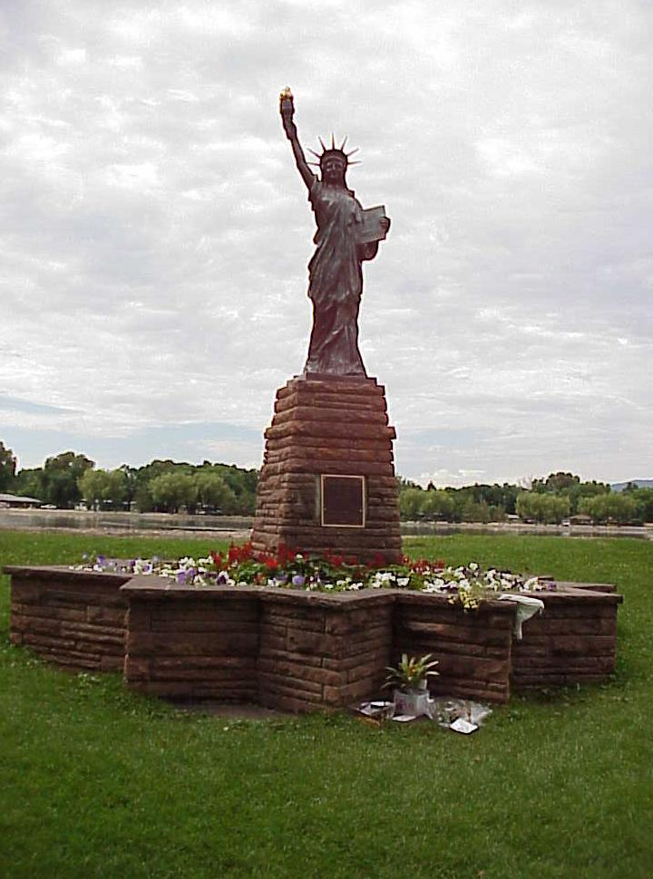
6 Community Parks

Slide 8
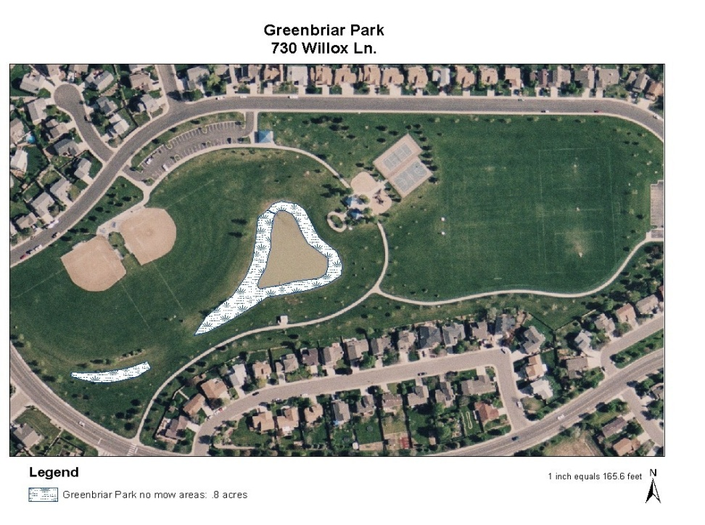
49 Neighborhood & Pocket Parks

Slide 9
70 Miles of Medians & Parkways

Slide 10
36 Miles of Recreational Trails

Slide 11
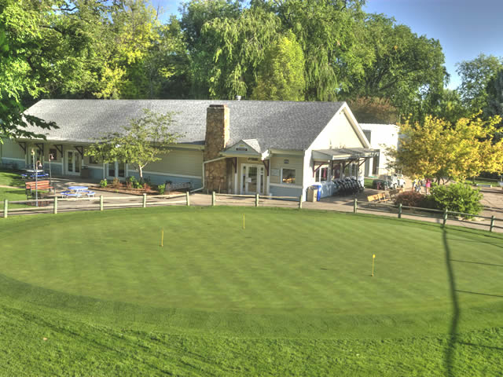
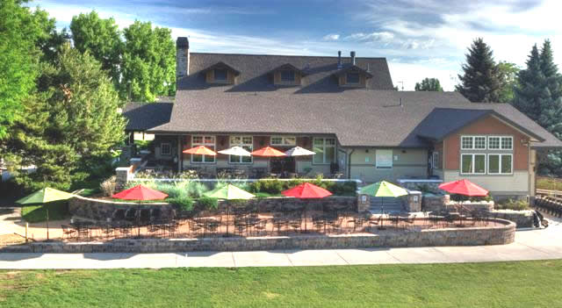
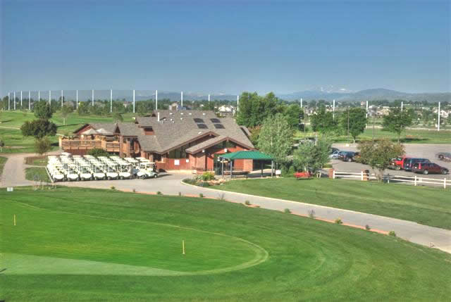
3 Municipal Golf Courses: City Park Nine, Collindale & Southridge

Slide 12
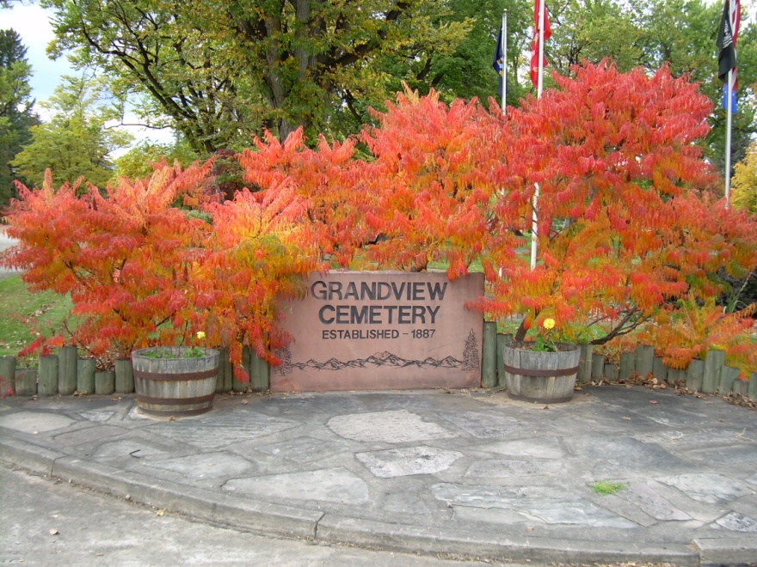
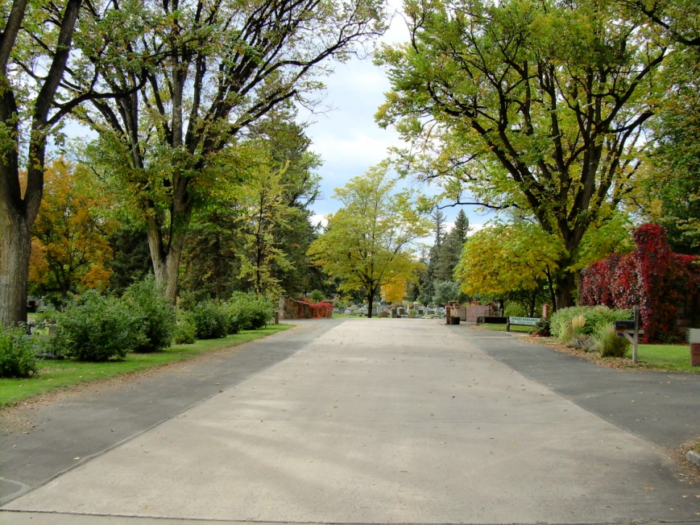
2 Memorial Parks: Grandview & Roselawn Cemeteries

Slide 13
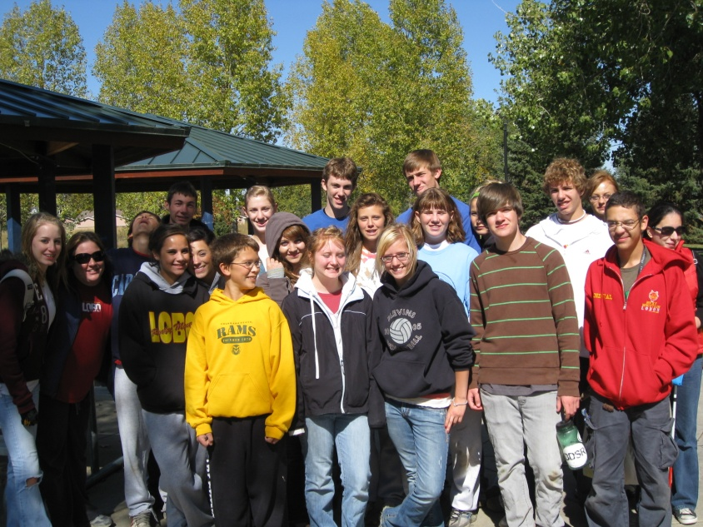
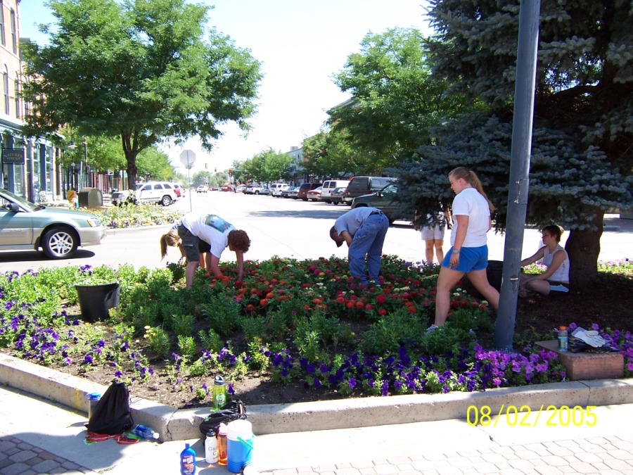
We develop partnerships with multiple volunteer groups and agencies

Slide 14
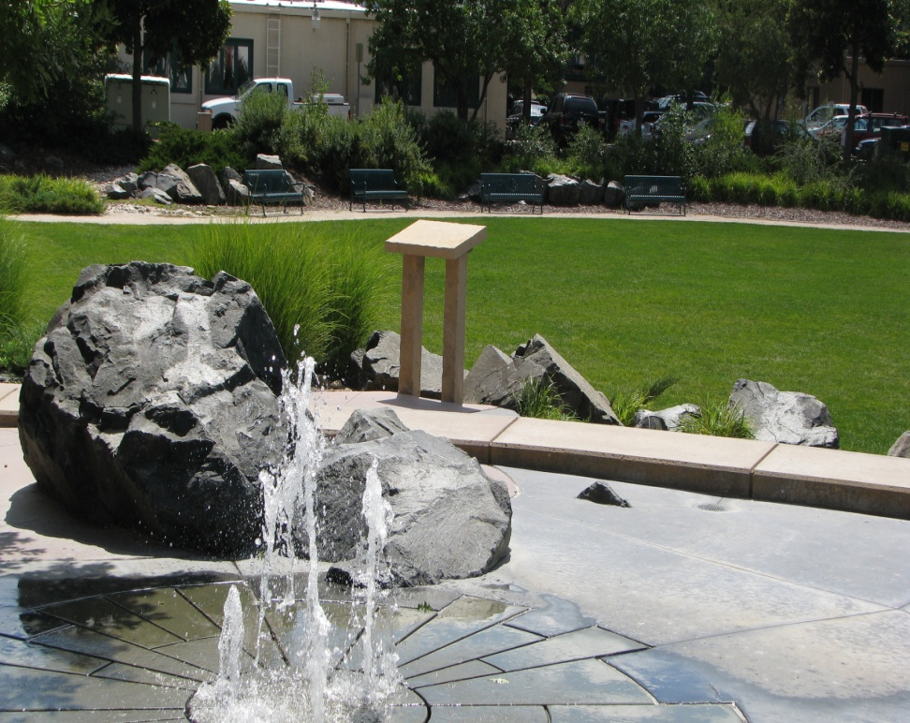
DBA and Larimer County

Slide 15
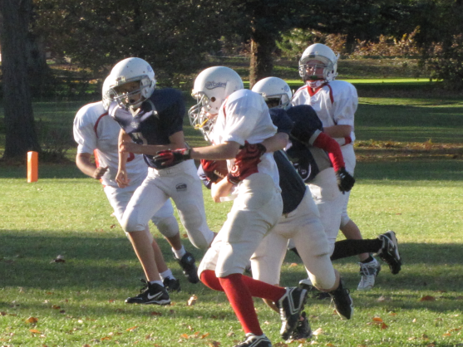
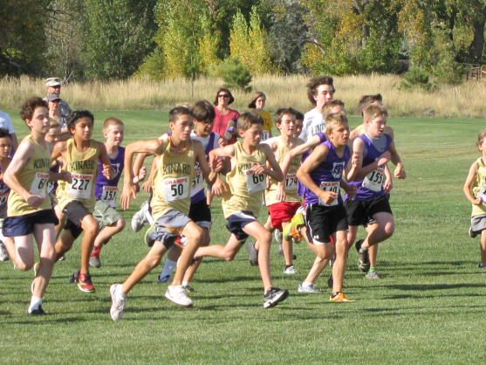
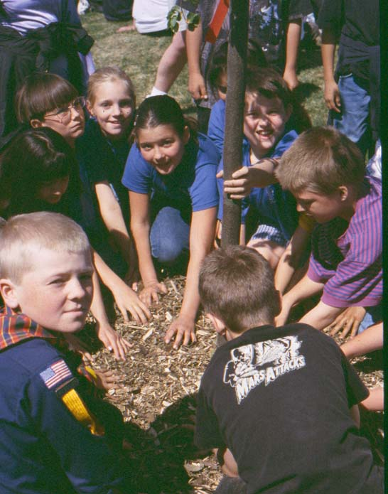
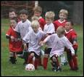
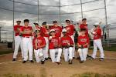
PSD, Youth Baseball, Youth Soccer, City Recreation, CSU, and others
Recreation Cross County
PSD Arbor Day
Fort Collins Soccer Club
Fort Collins Baseball Club
CSU Baseball
Recreation Football

Slide 16
Current Objectives Operational Excellence
Improve Customer Service - Provide excellent customer service to create a positive customer experience.
Create a Culture of Sustainability - Manage resources through innovative and sustainable practices.
Ensure Fiscal Sustainability - Manage our fiscal resources efficiently.
Engaged Workforce - Employees are our greatest resource, foster that relationship.
Achieve World Class Outcomes - What did I do today that was world class?

Slide 17
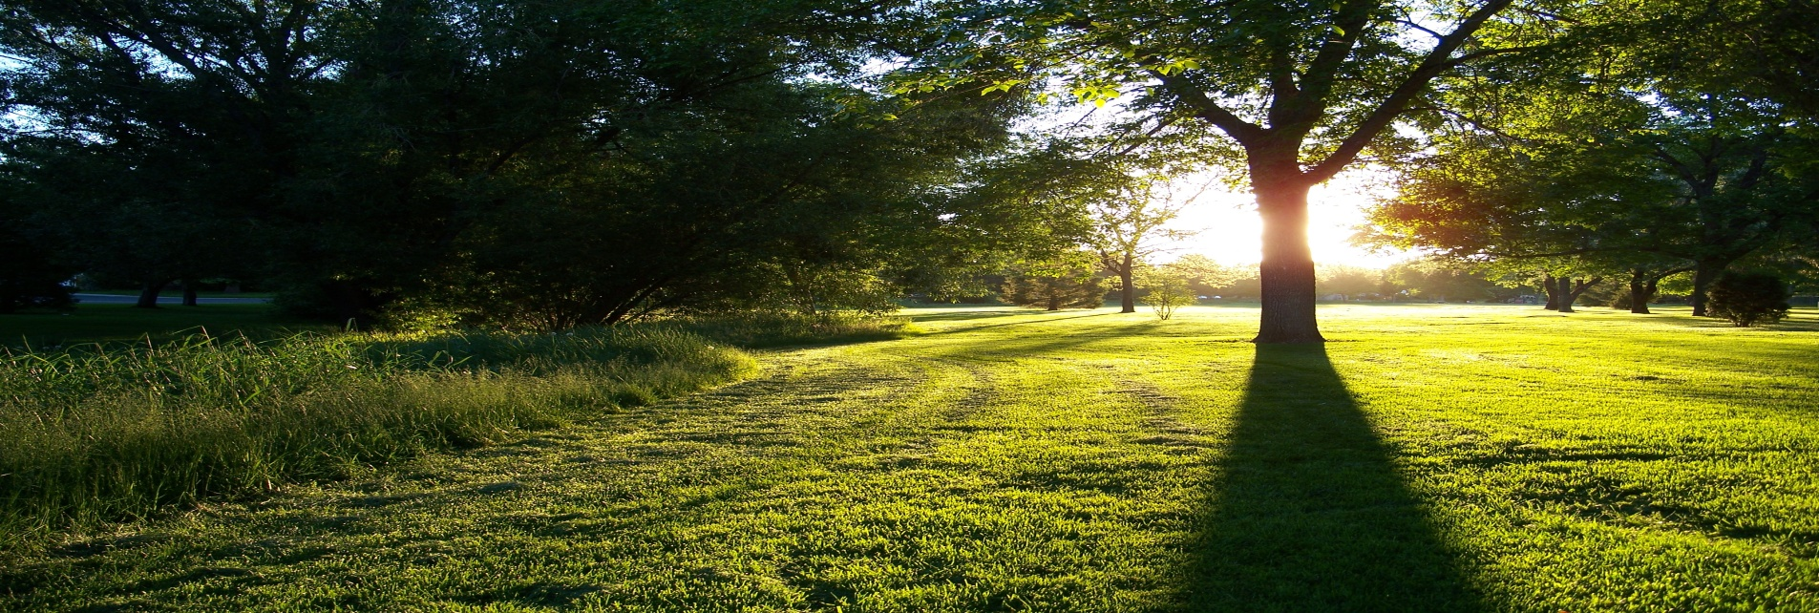
Parks offers a retreat for relaxation and provides a variety of events and activities that promotes health and well-being of the community.
Whatever your interests, the Fort Collins park system has something for you.

